Slide 1
Tool
Collaboration
Agent
One command
One action
Work with humans
Autonomously
complete tasks
to complete tasks

Slide 2

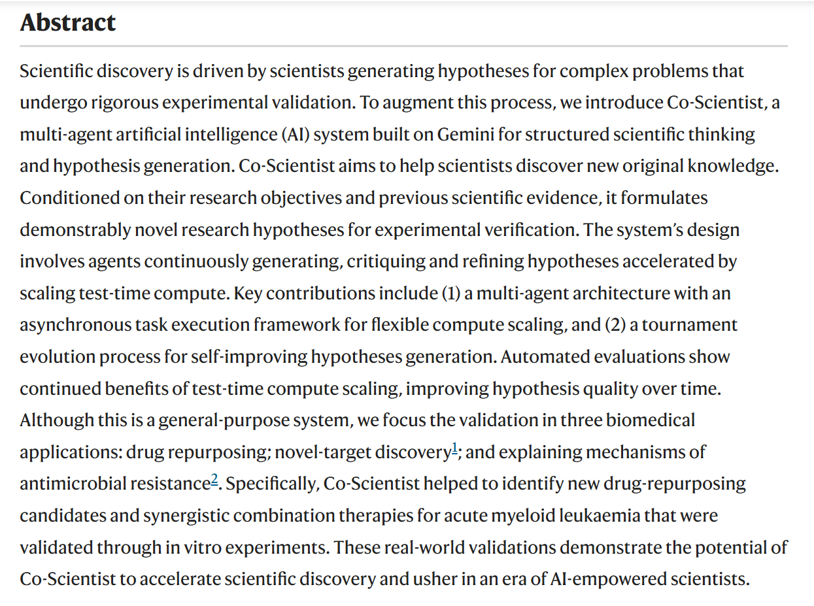
Automated researchers can reliably mitigate alignment failures
https://www.anthropic.com/research/automated-researchers-mitigate-alignment-failures
Automated AI Safety Research with Claude
Literature review, solution design, training & testing across 10 alignment failure types
Accelerating scientific discovery with Co-Scientist
https://www.nature.com/articles/s41586-026-10644-y
Gemini Multi-Agent “AI Co-Scientist”
Literature search, hypothesis generation, critique, ranking & iterative refinement
Real-World Biomedical Validation
Drug repurposing, target discovery, antimicrobial resistance & experimental validation

Slide 3
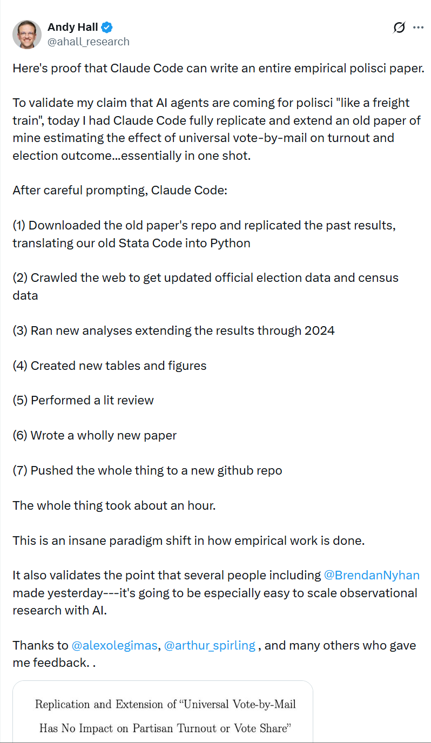
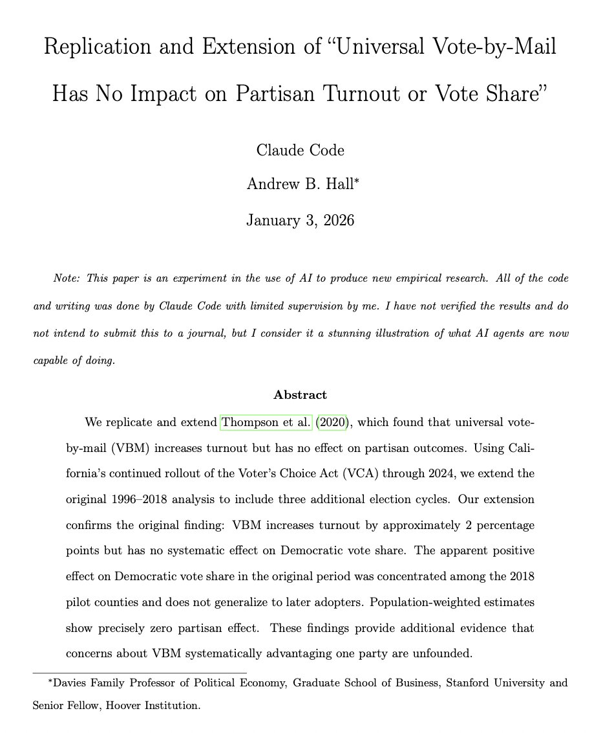
For researchers, can it autonomously write an entire research paper?
https://x.com/ahall_research/status/2007603340939800664

Slide 4
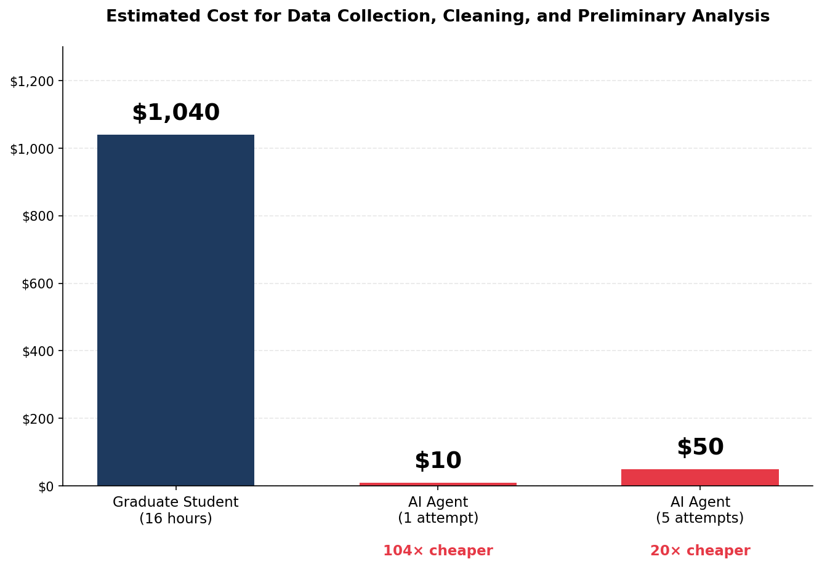
For researchers, can it autonomously write an entire research paper?
https://freesystems.substack.com/p/the-100x-research-institution

Slide 5
For researchers, can it autonomously write an entire research paper?
https://freesystems.substack.com/p/the-100x-research-institution
Living Research
Continuously updated research
New data → automatic re-analysis → updated conclusions
Automated Replication
Automatic reproducibility checks
Re-run analyses from raw data before publication
Synthesis at Scale
Large-scale evidence synthesis
Analyze massive datasets and research questions at scale
Research Swarm
Multi-agent research collaboration
Generate, evaluate, execute, and review research ideas autonomously

Slide 6
For researchers, can it autonomously write an entire research paper?
From Labor to Collaboration: A Methodological Experiment Using AI Agents to Augment Research Perspectives in Taiwan's Humanities and Social Sciences
https://arxiv.org/abs/2602.17221
Stage | Name | Human Role | AI Agent Role | Expected Output
0 | Research Planning & Agent Configuration | Define research questions and identify data sources | Support structured thinking and set up the document framework | Research plan and project structure
1 | Literature Collection | Define search scope and assess relevance | Conduct searches and organize literature | Structured literature database
2 | Literature Analysis | Provide theoretical interpretation and validate findings | Perform thematic analysis and identify research gaps | Literature analysis report
3 | Data Understanding & Exploration | Interpret the meaning of the data and determine analysis directions | Read datasets and conduct descriptive statistics | Data structure documentation
4 | Data Analysis & Visualization | Define analytical questions and interpret results | Perform analysis and generate visualizations | Analysis results and charts
5 | Paper Writing | Review content and provide theoretical interpretation | Draft different sections of the paper | Initial paper draft
6 | Reference Management | Complete missing information and verify accuracy | Extract citations and format references | Reference list

Slide 7
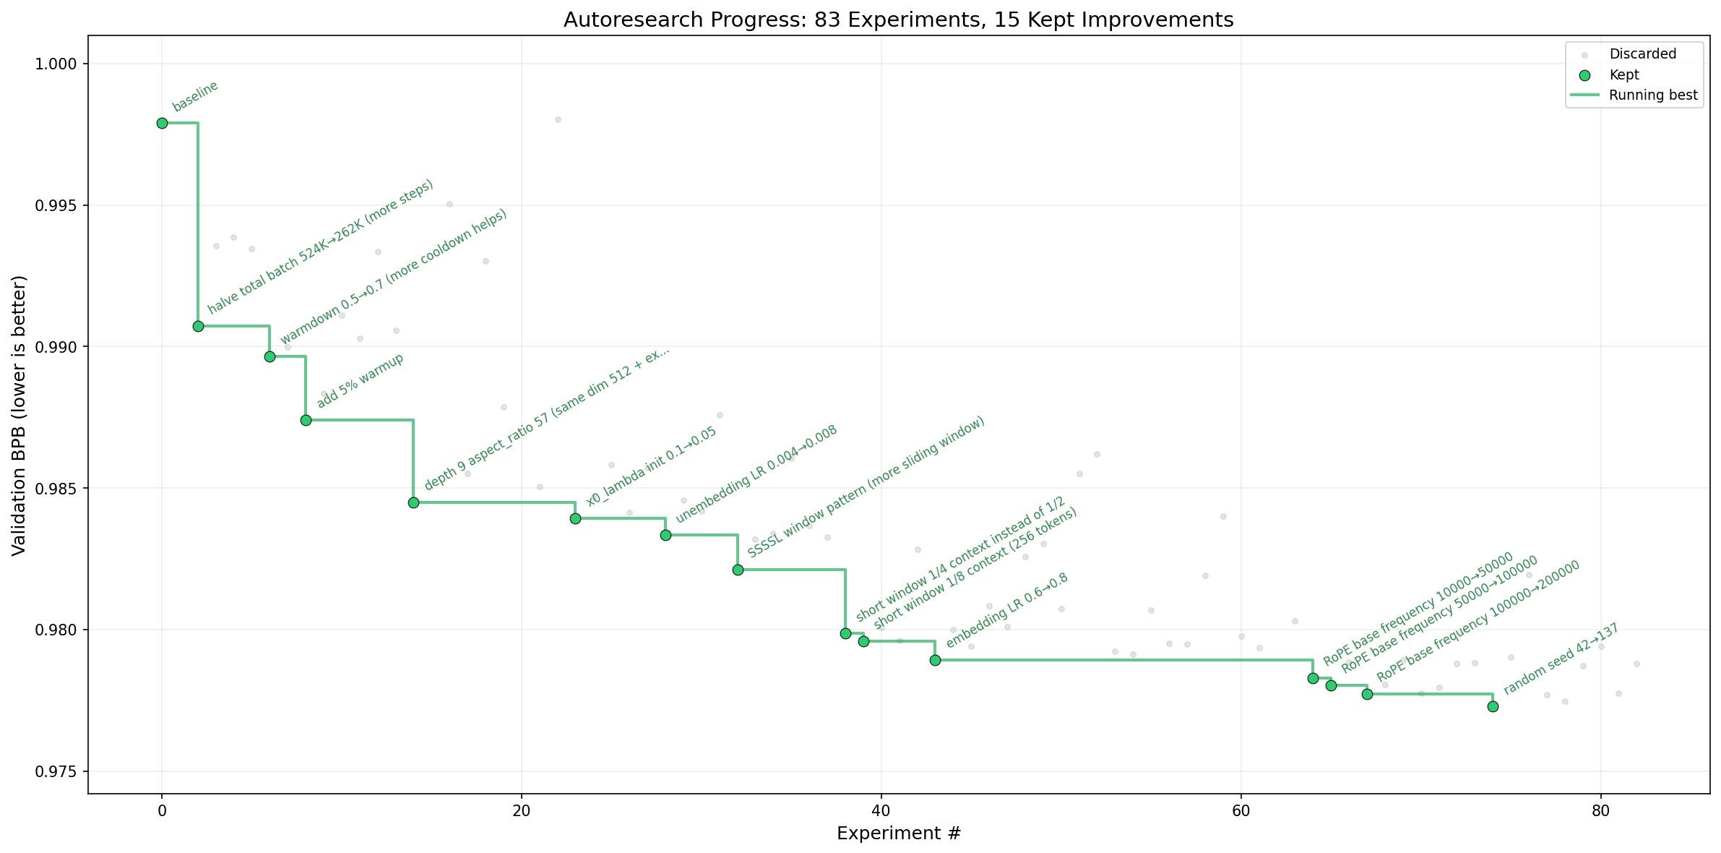
AI agents running research on single-GPU nanochat training automatically (Andrej Karpathy)
https://github.com/karpathy/autoresearch

Slide 8
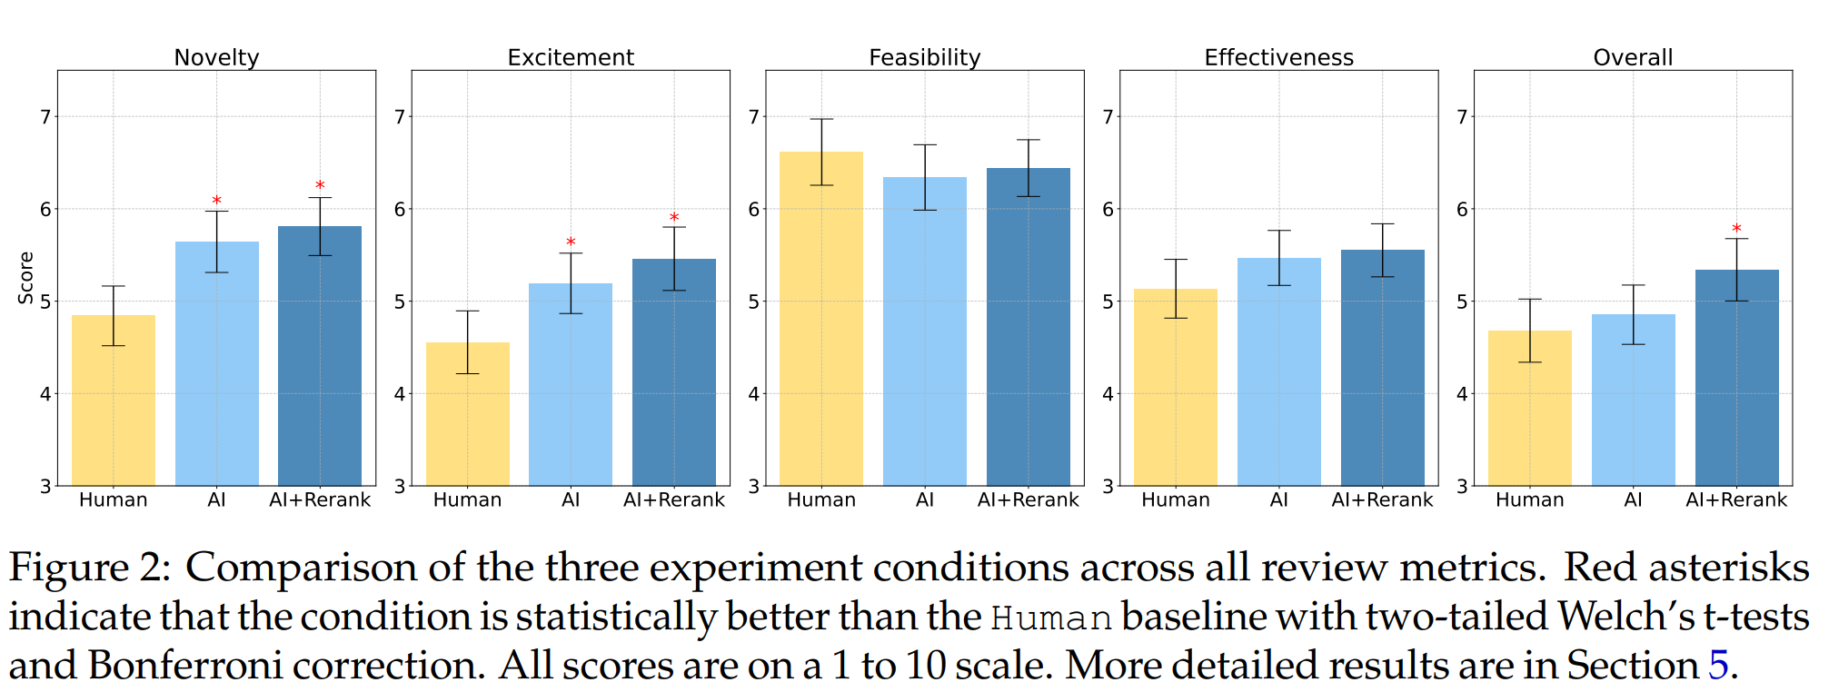
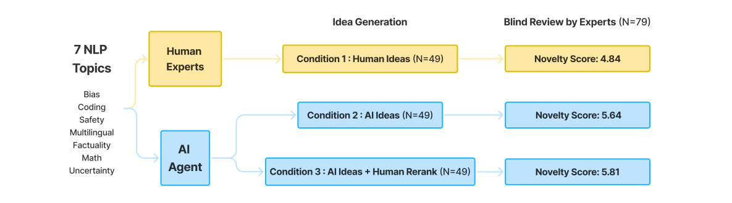
Can LLMs Generate Novel Research Ideas? A Large-Scale Human Study with 100+ NLP Researchers
https://arxiv.org/abs/2409.04109

Slide 9
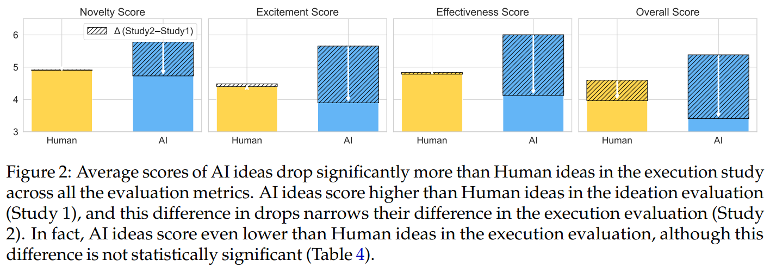
The Ideation–Execution Gap: Execution Outcomes of LLM-Generated versus Human Research Ideas
https://arxiv.org/pdf/2506.20803

